Slide 1

VERQUVO® 2023 Marketing Budget Optimization
Impact Assessment & Investment Optimization
HH Digital, Data and Analytics (HHDDA)
Aug 17th, 2023

Slide 2
Custom Vendor-Level Constraints
Maximum vendor-level constraints are less than estimated in-scope¹ budget of $14M for 2024. As a result, scenarios on next slide will reflect this (i.e., total budget must be between min/max constraints). In each scenario, please note that almost all channels tend to reach (or nearly reach) max constraints. Those channels are highlighted here.
If the $14M in-scope¹ budget is preferred for 2024 scenarios, these constraints must be adjusted.
Dropping TrendMd/DGC/Dox=-$242K spend Adding Numedis/ReachMD =~ +$550K spend NET =~+$308K
¹In-Scope channels : HCP MCM, HCP MMF, HCC InOffice, HCC Social, HCC Display, HCC Paid Search, Samples and Vouchers

Slide 3
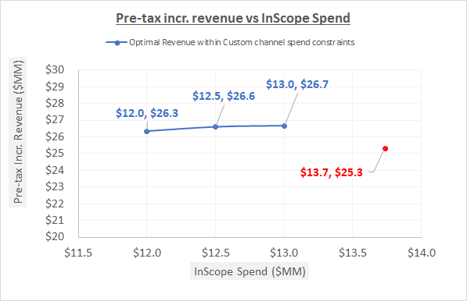
Optimal Scenarios with Custom Constraints
A reduction in the current in-scope¹ budget yields a small gain in revenue simply by optimizing within vendor/channel constraints.
By optimizing a slightly reduced in-scope¹ budget ($12M-$13M), a $1M-$1.3M gain in Revenue is estimated.
Please note: the $13.7M excludes the 3 HCP vendors that out of consideration for 2024.
These calculations assume that the non-analyzable budget can decrease proportionately to the in-scope budget
¹In-Scope channels : HCP MCM, HCP MMF, HCC InOffice, HCC Social, HCC Display, HCC Paid Search, Samples and Vouchers

Slide 4
Optimal Scenario deep dive (custom constraints)
A reduction in the current in-scope¹ budget yields a small gain in revenue simply by optimizing within vendor/channel constraints.
*Samples are requested and received by prescribers for use by and benefit of patients. Samples provide the opportunity to gain experience with a product. The sample-related values shown here reflect the association between samples and new patient starts rescaled into TRx terms for comparability to other investment types; this applies to vouchers as well, which are treated as an alternative mechanism to provide samples to patients. (vs. samples left by Field personnel).

Slide 5
APPENDIX

Slide 6
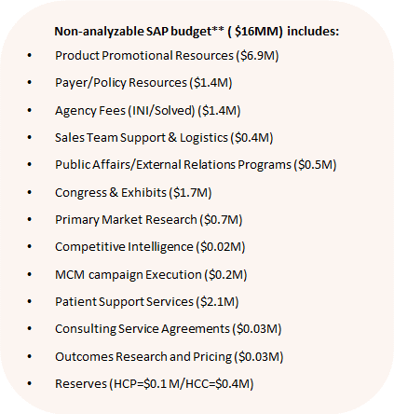
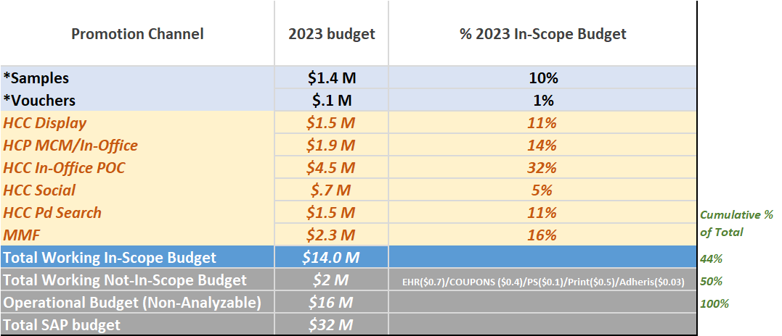
In-Scope Promotion Budget for Analysis
~44% ($14M) of the total 2023 VERQUVO® promotion budget was analyzed
The combined working budget represents 50% of the total budget
* Includes only Cost of Goods (COG) for Samples and reimbursement cost for Vouchers
**Source: Media Plans dated July’23, SAP Report dated June’23

